Slide 1
Low-Cost Precipitation Phase Partitioning Using Acoustic Data and Machine Learning in the Edge
Christian Skalka, Rachael Chertok, Julia Sober. Soheyl Faghir-Hagh, Tian Xia

Slide 2
Introduction
Precipitation phase partitioning: difficult problem to solve (CITE articles?)
Rain on Snow Event detection: one of the 23 unsolved problems in hydrology [1]
Even recording telemetry is a problem:
Sensors can be expensive: cost, power consumption, and footprint (?-how is footprint different from power consumption?)
Our approach: Low cost AI enabled IoT systems, using acoustic sensors.
Great products w/ good temporal & spatial resolution (Does great products refer to the acoustic sensors? Or the device we’re making?)
[1] Gunter Bloschl, Marc FP Bierkens, Antonio Chambel, Christophe Cudennec, Georgia Destouni, Aldo Fiori, James WKirchner, Jeffrey J McDonnell, Hubert HG Savenije, Murugesu Sivapalan, et al. Twenty-three unsolved problems inhydrology (uph)–a community perspective. Hydrological sciences journal, 64(10):1141–1158, 2019

Slide 3
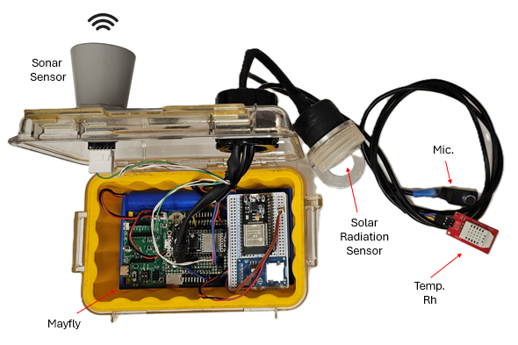
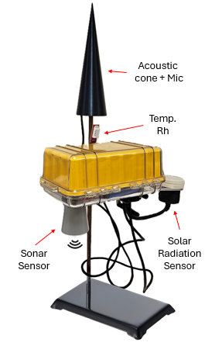
Background and Project Description
Previous work performed with AI based phase partitioning using acoustic features
Classifying rain and rain intensity
Overall Idea:
Audio recorded via a microphone
Features extracted from this audio via signal processing
Features provided to ML models trained to classify precipitation phase
Critical to embed the entire prediction workflow on device
Streaming sound data is too costly
Keeping on embedded device enables smart sampling

Slide 4
Work Flow
If dew point > 100 - ∑
No: Wait x minutes, then resample
Yes
Microphone
.wav file labeled by precipitation type
Audio Signal in Time Domain
Fast Fourier Transform
Short Time Fourier Transform
Extract features from time domain:
Extract Features from frequency domain (spectrogram):
MFCCs
Use as input features to ML models: SVM and Random Forests
Outputs: Classified precipitation phase
Light rain, heavy rain, light hail, heavy hail, snow, silence

Slide 5
Machine Learning Technologies
Models must be able to fit on embedded device
Negates use of deep learning (+data requirement)
Models Used:
Random Forests
Support Vector Machines (SVM)
XGBoost (ruled out, too computationally expensive)
Logistic Regression (too simple for this data, did not converge)
Signal processing performed to extract audio features:
Time domain: four possible temporal features
Frequency domain: 12 possible spectral features
MFCCs: Mel Frequency Cepstral Coefficient
Insert Image?

Slide 6
Machine Learning Results Using Synthetic Data
Input features to ML models retrieved from synthetic data
Considerations: accuracy vs power & memory needed for model and feature extraction
Current model results, on synthetic data, as follows (in percentages):
If there are any profiling/any other results we want, I think they can go here

Slide 7
Current and Future Work
Collecting real weather audio
Refining models using real data
Decide on MFCCs vs temporal/spectral features
Refining hardware for remote deployment
Integration into LoRA network
Near Real Time Reporting
Insert Image?

Slide 8
Supplemental Slides

Slide 9

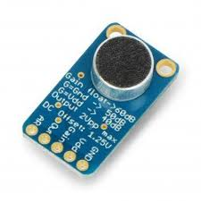



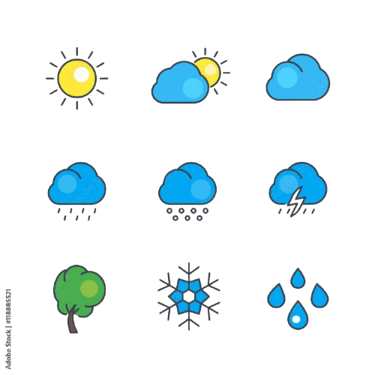
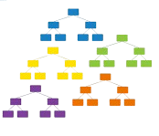
MFCC Extraction Flow Chart
Microphone
Record .wav files onto the SD card
ADC
Pin A0
Read the .wav file from SD
Apply Windowing
Calculate and Save MFCCs onto the SD card
Log and Discrete Cosine Transform
Mel Filter Bank
Discrete
Fourier
Transform
1. Heavy hail
2. Light hail
3. Heavy rain
4. Medium rain
5. Light rain
6. Snow
7. Silence
Feed the MFCCs to the Random Forest
Model
Read the MFCC.csv
from SD
Results

